Slide 1
Artificial & Computational Intelligence
Session 3: Problem Solving Agent using Uninformed Search

Slide 2
Lecture Outline
Problem Formulation – Examples
Algorithms: BFS, Uniform cost Search, DFS, Depth Limited Search, Iterative Deepening Search, Bidirectional Search
Comparisons of algorithms
Reference: Chapter 3.1-3.4 from AI: A modern approach (Russell, Norvig)

Slide 3
Agent Architecture Recap
Goal based Agent
Problem Solving Agents

Slide 4
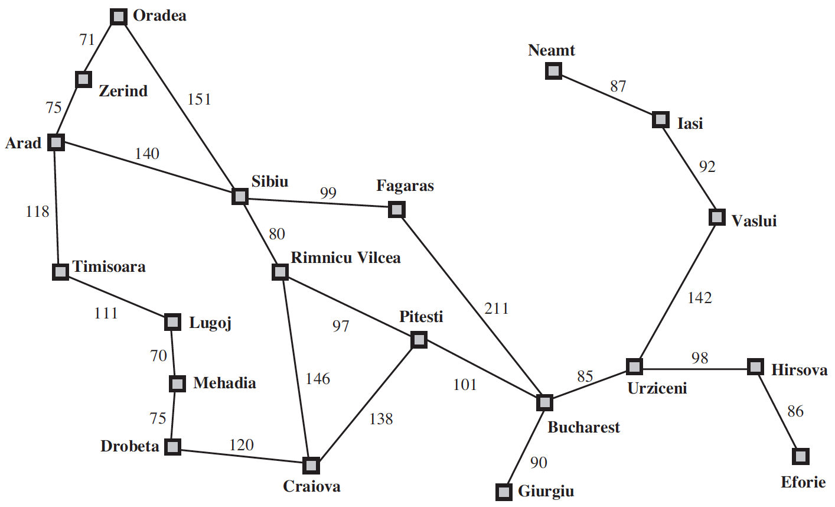
Problem Solving Agents
Agent is here

Slide 5
Problem Solving Agents
Agent is holidaying in Arad.
Many factors in its performance measure
Tour the famous places
Try local cuisine
Souvenir Shopping

Slide 6
Problem Solving Agents
Agent is here
Goal

Slide 7
Problem Solving Agents
Goal Formulation
Optimizes the agent’s objectives
Thereby, limits the actions that can be taken

Slide 8
Problem Solving Agents
In order to reach the Goal – Bucharest
Several States and Actions are possible
Agent can drive to airport or can hire a taxi or take a bus
Agent can take a detour to another city and board a flight to Bucharest
Problem Formulation: Process of deciding what actions and states to consider, given a goal

Slide 9
Problem Solving Agents
Unknowns about the Environment
Doesn’t know what state the agent is in
Estimation of number of possible actions
Doesn’t know the value of actions
Doesn’t know the resulting state of actions
Assumptions about the Environment
Observable: Agent always knows the current state
Discrete: At any given state, only finitely many actions to choose from
Known: Knows which states are reached by each action
Deterministic: Each action would always have the same resulting state

Slide 10
Problem Solving Agents
Under these assumptions, the solution would be
A Fixed Sequence of Actions
Search: The process of looking for a fixed sequence of actions that reaches a goal
Search Algorithm: Takes problem as input and outputs sequence of actions

Slide 11
Problem Solving Agents
Formulate – Define the problem and its components
Search – Solve the problem using search algorithms
Execute – Execute the solution of fixed sequence of actions

Slide 12
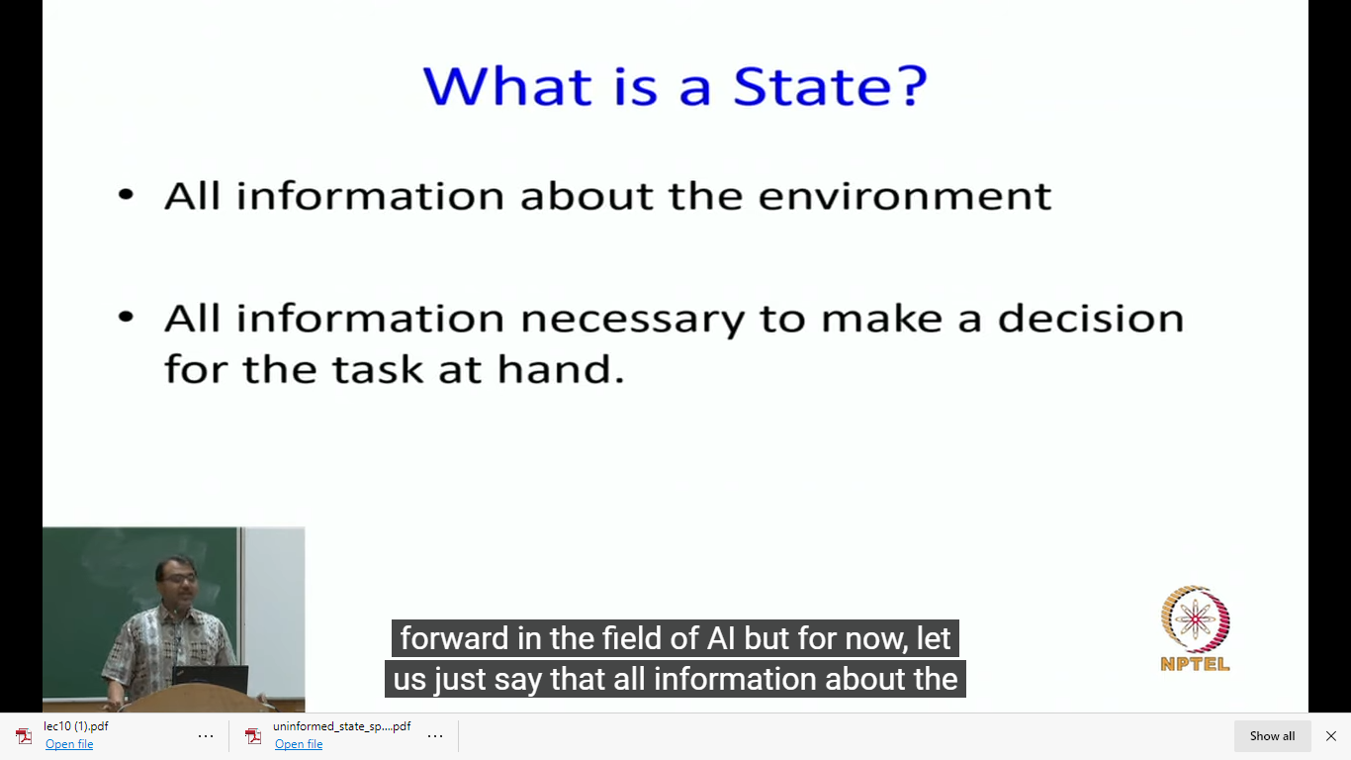
Notion of a state

Slide 13
Problem Solving Agents – Formulate
A problem can be formulated using five components
Initial State – The agent’s starting state. E.g., In(Arad)
Possible Actions – Set of applicable actions in a given state. E.g., from the state s = In(Arad), applicable actions
ACTIONS(s) ➔ {Go(Sibiu), Go(Timisoara), Go(Zerind)}
Transition Model – The resulting state of an action in a given state, modeled as RESULT(s, a)
RESULT( In(Arad), Go(Sibiu) ) = In(Sibiu)
Goal Test – Determines whether a given state is a goal state.
IsGoal( In(Bucharest) ) = Yes
Path Cost – A function that assigns a numeric cost to each path. A path is a series of actions. Each action is given a cost depending on the problem.
cost( In(Arad), go(Sibiu)) = 140 kms

Slide 14
Problem Solving Agents – Formulate
In the above definition
Many possible states – In(Arad), the agent has many possibilities in real world, e.g., can be in the middle of Arad, near an airport, shopping center, hotel, etc.
Many possible actions – Agent can take several actions while driving from Arad to Sibiu. It can halt at a place, take a detour, turn the radio on.
However, they are irrelevant for finding the solution of path to Bucharest
Hence, can be abstracted
Abstraction – Process of removing detail from a representation

Slide 15
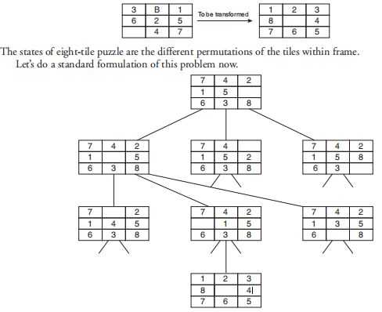
Problem formulation of the Eight Tile Puzzle
The eight tile puzzle consist of a 3 by 3 (3 × 3) square frame board which holds eight movable tiles numbered 1 to 8. One square is empty, allowing the adjacent tiles to be shifted. The objective of the puzzle is to find a sequence of tile movements that leads from a starting configuration to a goal configuration.

Slide 16
Problem formulation of the Eight Tile Puzzle
States: It specifies the location of each of the eight tiles and the blank in one of the nice squares.
Initial state: Any state can be designated as the initial state.
Goal: Many goal configurations are possible.
Legal moves (or state): They generate legal states that result from trying the four actions:
Blank moves left
Blank moves right
Blank moves up
Blank moves down
Path cost: Each step costs 1, so the path cost is the number of steps in the path.

Slide 17

Formulate – Vacuum Cleaner Example
Vacuum World

Slide 18
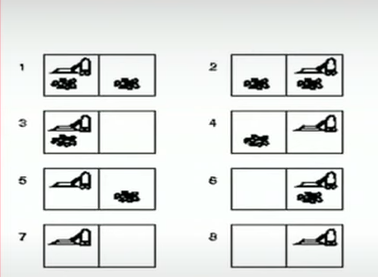
States in Vacuum Cleaner

Slide 19
Formulate – Vacuum cleaner Example
Possible States – There are two locations and two possibilities of dirt. Hence, there would be a total of 8 possible states, i.e., 2x2²
Initial State – Any state with position of agent and dirt mentioned
Actions – Three possible actions, Left, Right, Suck
Transition Model – Left would move the agent to left location, except when the agent is in leftmost location, there would be no effect. Similarly for Right action. Suck would remove the dirt, if any.
Goal Test – Checks whether all locations are clean
Path cost – Each step costs 1, so the path cost is total number of steps

Slide 20
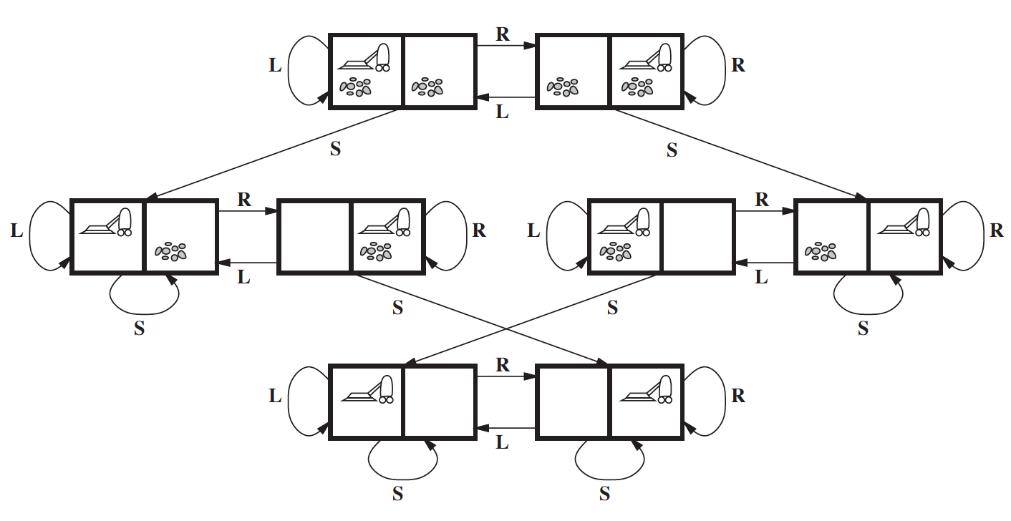
Formulate – Toy Problem Example

Slide 21
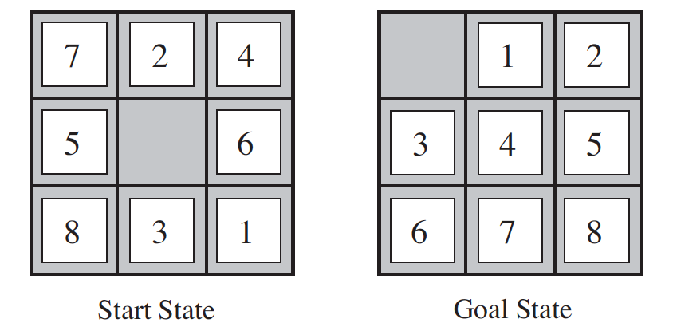
Formulate – Toy Problem Example
8-puzzle

Slide 22
Formulate – Toy Problem Example
Initial State – Any permutation of 1-8 numbers with a blank
Actions – Movement of blank space either by Left, Right, Up or Down
Transition Model – The resulting state after moving the blank space will replace the digit
Goal Test – Check whether the state matches the goal configuration
Path cost – Each step costs 1, so the path cost is total number of steps

Slide 23
Formulate – Real World Example
Airline Travel problem – the task of a travel agent to book cheapest and fastest flight route from City A to City B.
E.g., Need to Travel from Delhi to Los Angeles within Rs. 70,000
Possible States – Each state is a location and current time.
Initial State – Specified by User’s query
Actions – Flight from current location at a particular time with enough time for within-airport transfer if needed
Transition Model – The destination location and arrival time
Goal test – Are we at final destination at the specified time?
Path Cost – Flight cost + Duration + Waiting time + Immigration, etc.

Slide 24
Searching for Solutions
Solution for above Problems: A sequence of possible actions starting at the initial state and reaching the destination specified
Search Algorithms:
Given problem formulation as input, these algorithms would output the sequence of actions
Search Trees - Where states are nodes and actions are edges. The initial state will be the root node and possible actions are branches
In(Arad)
Parent Node
Go(Sibiu)
Go(Timisoara)
Go(Zerind)
In(Sibiu)
In(Timisoara)
In(Zerind)
Child Nodes

Slide 25
Searching for Solutions
In(Arad)
Generation
Go(Sibiu)
Go(Timisoara)
Go(Zerind)
Expansion
In(Sibiu)
In(Timisoara)
In(Zerind)
Search Problem: Which branch to generate next?

Slide 26
Tree Search Algorithm
In(Arad)
Go(Sibiu)
Go(Timisoara)
Go(Zerind)
In(Sibiu)
In(Timisoara)
In(Zerind)
Go(Arad)
Go(Fagaras)
Go(Oradea)
Go(Rimnicu Vilcea)
In(Arad)
In(Fagaras)
In(Oradea)
In(Rimnicu Vilcea)
Tree – Search Algorithm

Slide 27
Tree Search Algorithm
In(Arad)
Go(Sibiu)
Go(Timisoara)
Go(Zerind)
In(Sibiu)
In(Timisoara)
In(Zerind)
Go(Arad)
Go(Fagaras)
Go(Oradea)
Go(Rimnicu Vilcea)
In(Arad)
In(Fagaras)
In(Oradea)
In(Rimnicu Vilcea)
Leaf Nodes
(no children yet)
Frontier: Set of all leaf nodes available for expansion at any given point
Search Strategy: Choosing which state to expand next

Slide 28
Tree Search Algorithm
In(Arad)
Repeated State
generated by
Loopy Path
Go(Sibiu)
Go(Timisoara)
Go(Zerind)
In(Sibiu)
In(Timisoara)
In(Zerind)
Go(Arad)
Go(Fagaras)
Go(Oradea)
Go(Rimnicu Vilcea)
In(Arad)
In(Fagaras)
In(Oradea)
In(Rimnicu Vilcea)
Redundant Path: More than one way to reach a state from another.
E.g., Arad – Sibiu (140 kms) and Arad-Zerind-Oradea-Sibiu (297 kms)
Loopy Path is a special case

Slide 29
Graph Search Algorithm
To solve the Redundancy Path problem,
Explored Set: keeps track of states that are already visited
Augments the Tree-Search algorithm to solve redundancy
We call it Graph-Search Algorithm
Therefore, the search tree contains at most one copy of each state
Growing a tree directly on the state-space graph

Slide 30
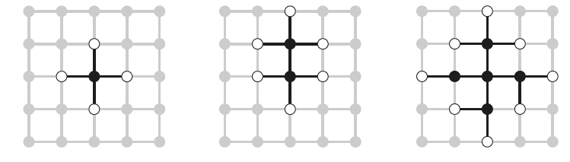
Graph Search Algorithm
Rectangular Grid Problem

Slide 31
Graph Search Algorithm

Slide 32
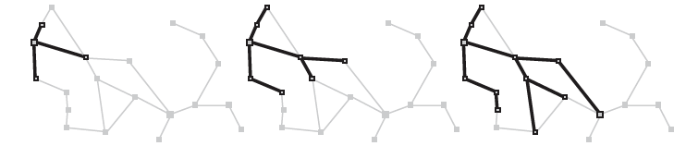
Graph Search Algorithm
Zerind
Arad
Sibiu
Timisoara

Slide 33
Infrastructure for Search Algorithms
For each node n of the tree,
n.STATE: the state in the state space to which node corresponds
n.PARENT: the node in the search tree that generated this node
n.ACTION: the action that was applied to parent to generate the node
n.PATH-COST: the cost, denoted by g(n), of the path from initial state to node
Parent
State = Sibiu
Action = Go(Sibiu)
Path Cost = 300kms
Node

Slide 34
Infrastructure for Search Algorithms
Nodes vs States
Node – a bookkeeping data structure used to represent the search tree
State – configuration of the world
Two different nodes might have same state – if that state is generated from two different paths
Frontier – needs to be stored in a queue with a strategy to help pick the next node for expansion
Strategies can be
FIFO (First In First Out) – Pops the oldest element of the queue
LIFO (Last In First Out) – Pops the newest element of the queue
Priority Queue – pops the element with highest priority

Slide 35
Measuring Search Algorithm Performance
Completeness – Is the algorithm guaranteed to find a solution when there is one?
Optimality – Does the algorithm find the optimal solution?
Time Complexity – How long does it take to find the solution?
Space Complexity – How much memory is needed to perform the search?

Slide 36
Measuring Search Algorithm Performance
Time and space complexity
Search in AI is represented by initial state, actions and transitions which usually result in infinite Nodes and Edges in a graph.
Hence, the complexity is rather measured by
Branching Factor b: Maximum number of successors of any node
Depth d of the shallowest goal, i.e., number of steps from initial node
Maximum length (m) of any path in state space

Slide 37
Measuring Search Algorithm Performance
Effectiveness of an algorithm can be measured by:
Search Cost: Time spent by the algorithm in finding a solution (can also include memory usage)
Solution Cost: Path cost of the solution
Total Cost: Search Cost + Solution Cost (if not in same units, convert them)

Slide 38
Search Algorithms
Uninformed Search Algorithms
No additional information about states beyond what is provided in problem formulation
Generate successors and distinguish a goal state from a non-goal state
Informed Search Algorithms
Strategies that know if one non-goal state is more promising than another non-goal state
Also called Heuristic Search strategies

Slide 39
Uninformed Search Algorithms
Breadth First Search
Uniform Cost Search
Depth First Search
Depth Limited Search
Iterative deepening Depth First Search

Slide 40
Breadth First Search

Slide 41
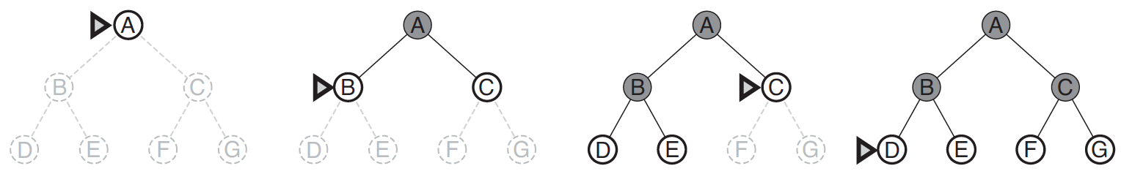
Breadth First Search (BFS)
Initially fringe is 1. A
2. B C goal node: F
3. C D E
4. D E F G
E F G PATH: A- C-F: COST:1+1:2
F G
Generate all nodes at a given depth before proceeding to deeper nodes

Slide 42
Breadth First Search
All nodes at a given depth are expanded first before any nodes at next level
FIFO queue for Frontier
Shallowest (min depth) unexpanded node is chosen for expansion
Instance of general graph-search algorithm
Discards any redundant path by checking with Explored Set and Frontier Set (must have a path shallower which was seen before)
Hence, it always has the shallowest path to every state

Slide 43
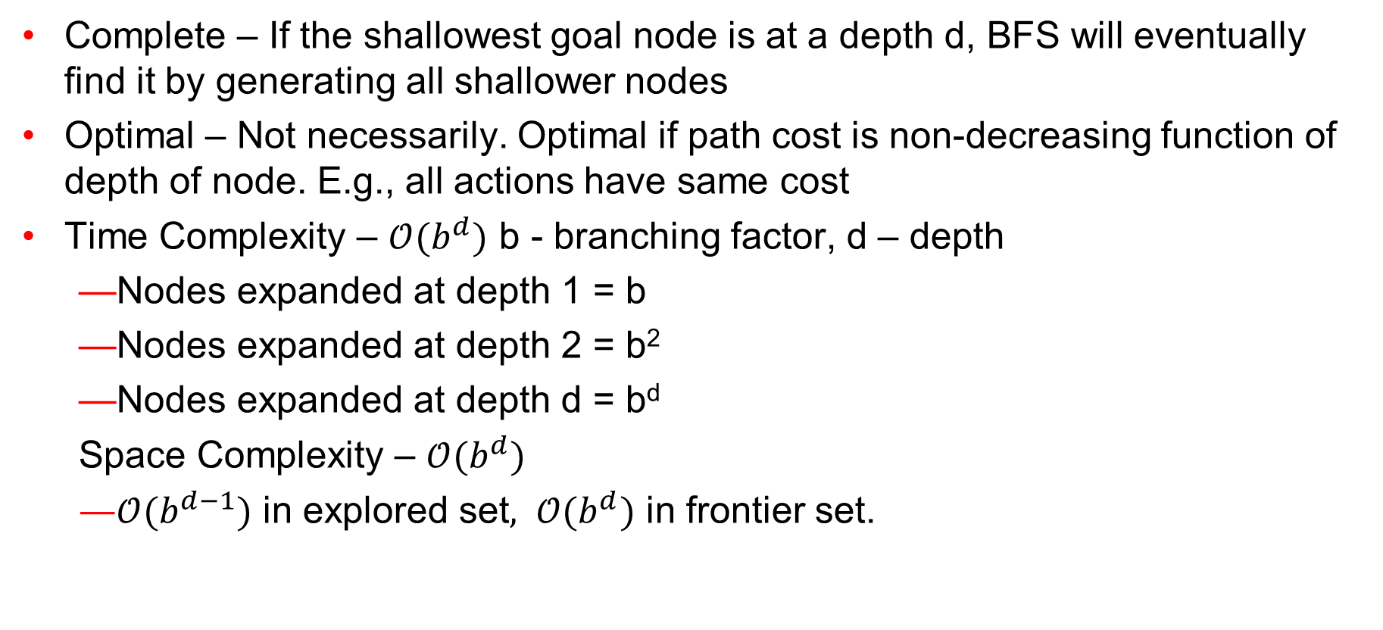
Breadth First Search – Evaluation
Complete – If the shallowest goal node is at a depth d, BFS will eventually find it by generating all shallower nodes
Optimal – Not necessarily. Optimal if path cost is non-decreasing function of depth of node. E.g., all actions have same cost
Time Complexity – $𝒪(b^{d})$ b - branching factor, d – depth
Nodes expanded at depth 1 = b
Nodes expanded at depth 2 = b²
Nodes expanded at depth d = b^{d}
Space Complexity – $𝒪(b^{d})$
$𝒪(b^{d−1})$ in explored set$, 𝒪(b^{d})$ in frontier set.

Slide 44
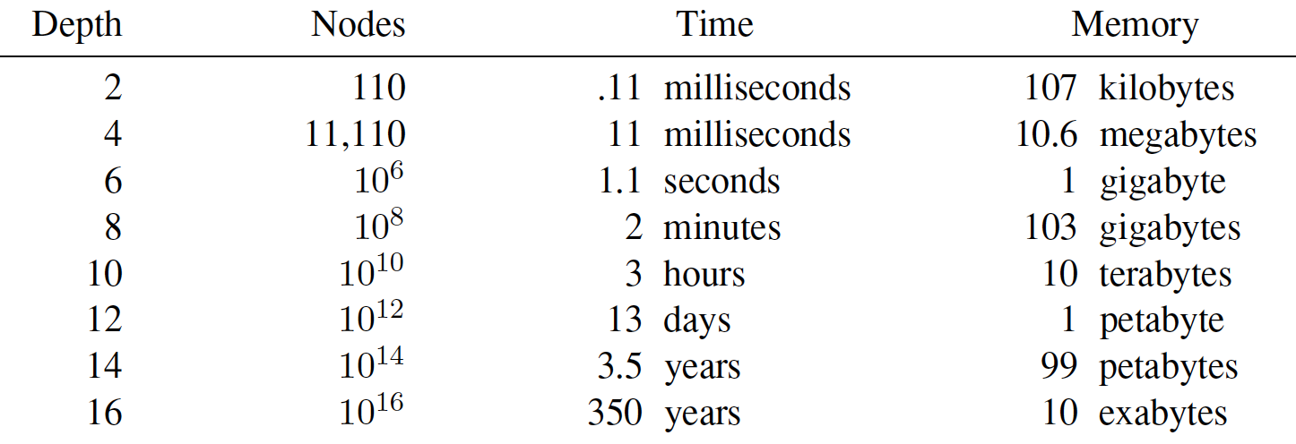
Breadth First Search – Evaluation
Why is Space Complexity a big problem? Imagine a problem with
branching factor b = 10
generates 1 million nodes/sec
Each node requires 1KB

Slide 45
Depth First Search

Slide 46
DFS EXAMPLE 1

Slide 47
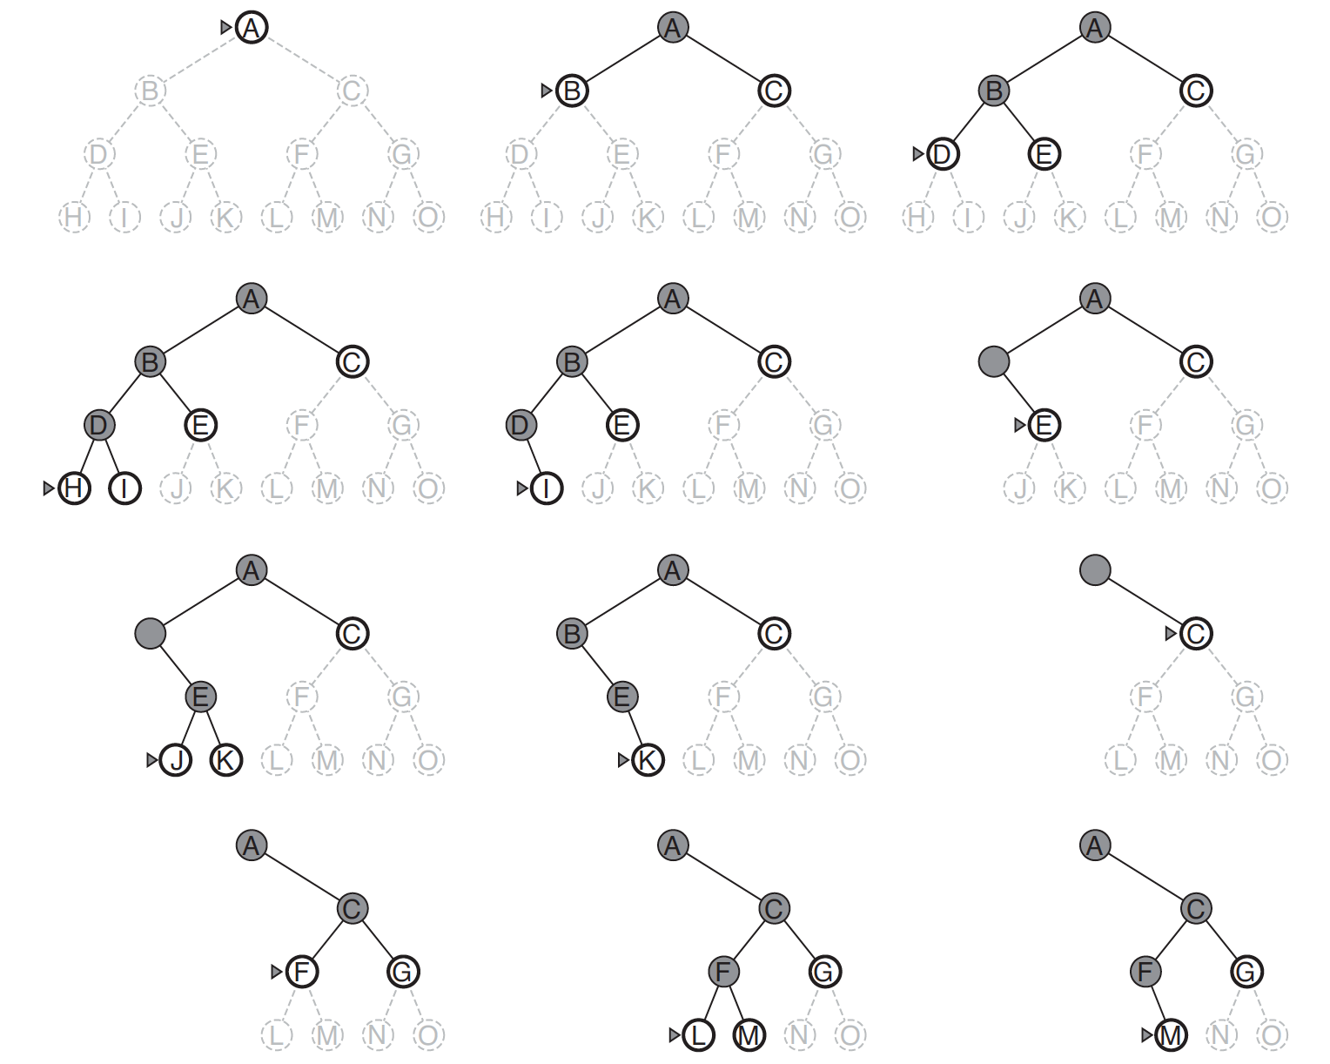
DFS EXAMPLE 2

Slide 48
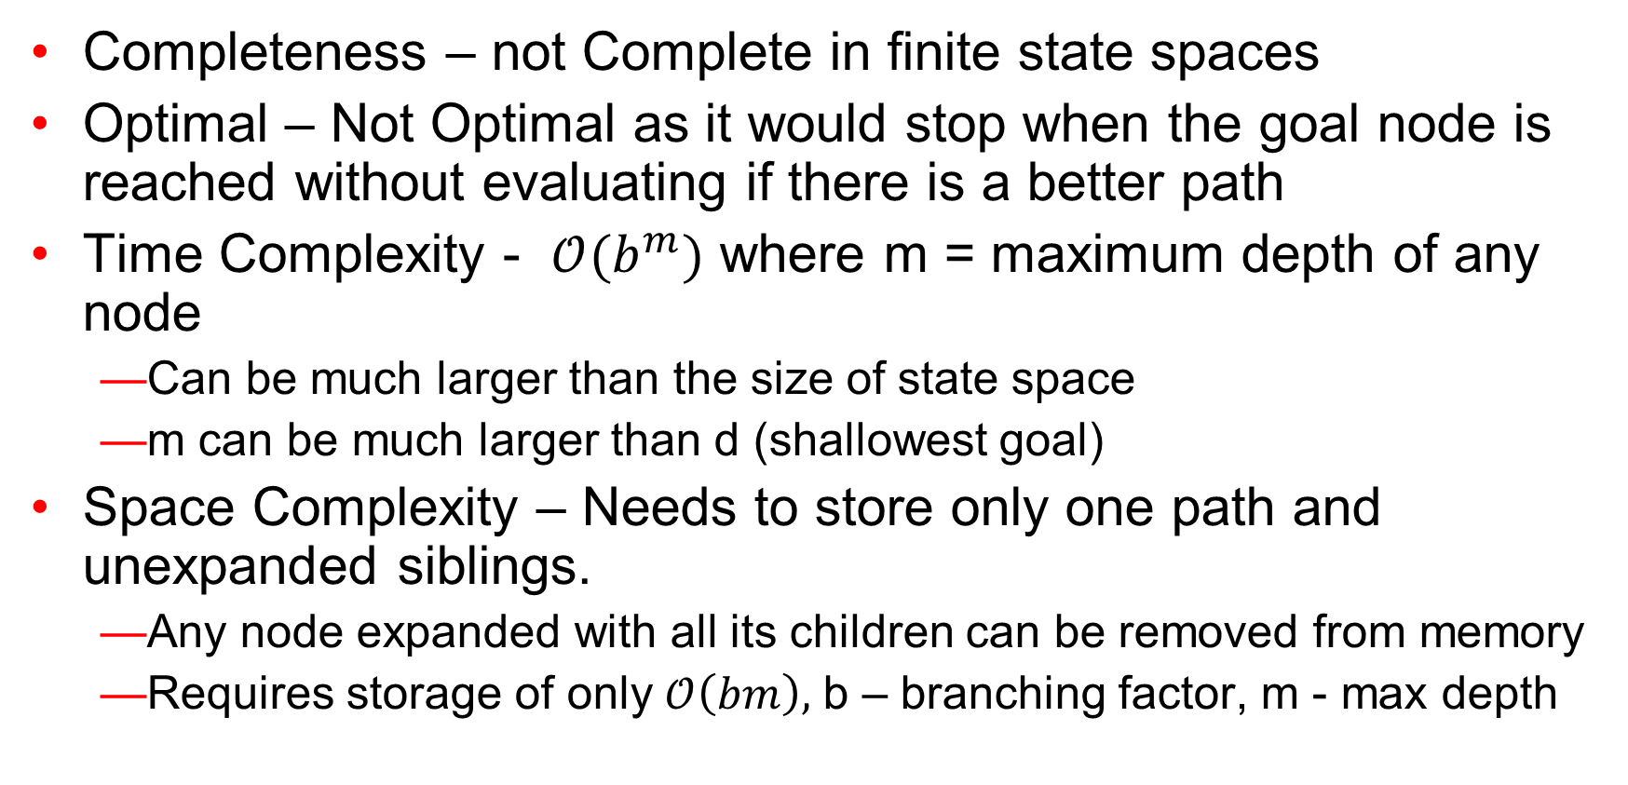
DFS - Evaluation
Completeness – not Complete in finite state spaces
Optimal – Not Optimal as it would stop when the goal node is reached without evaluating if there is a better path
Time Complexity - $𝒪(b^{m})$ where m = maximum depth of any node
Can be much larger than the size of state space
m can be much larger than d (shallowest goal)
Space Complexity – Needs to store only one path and unexpanded siblings.
Any node expanded with all its children can be removed from memory
Requires storage of only $𝒪\left(bm\right),$ b – branching factor, m - max depth

Slide 49
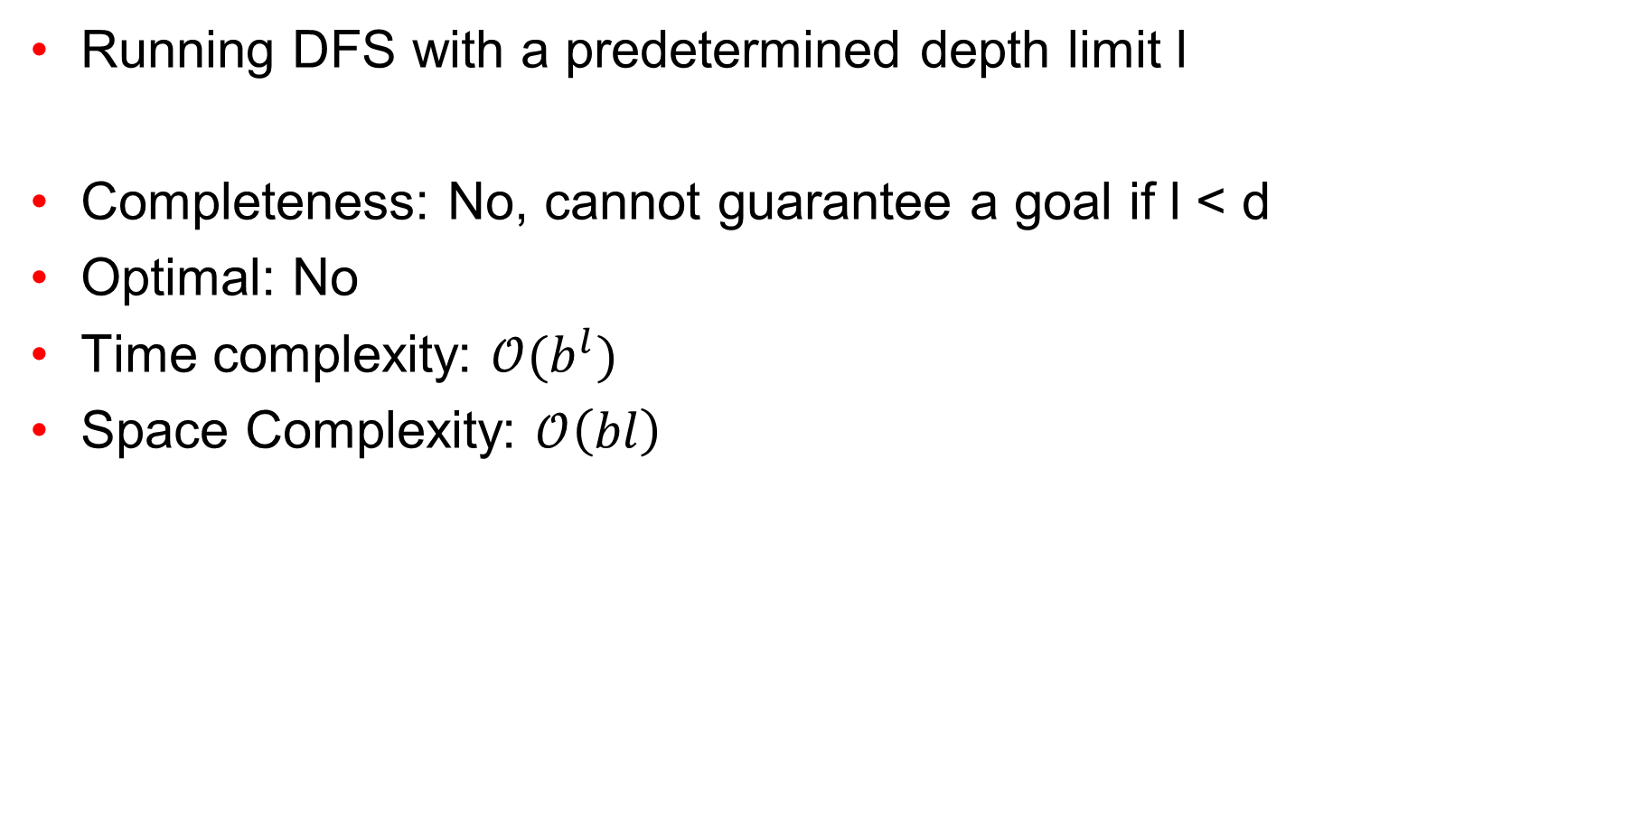
Depth Limited Search (DLS)
Running DFS with a predetermined depth limit l
Completeness: No, cannot guarantee a goal if l < d
Optimal: No
Time complexity: $𝒪(b^{l})$
Space Complexity: $𝒪\left(bl\right)$

Slide 50
Iterative Deepening Depth First Search (IDS

Slide 51
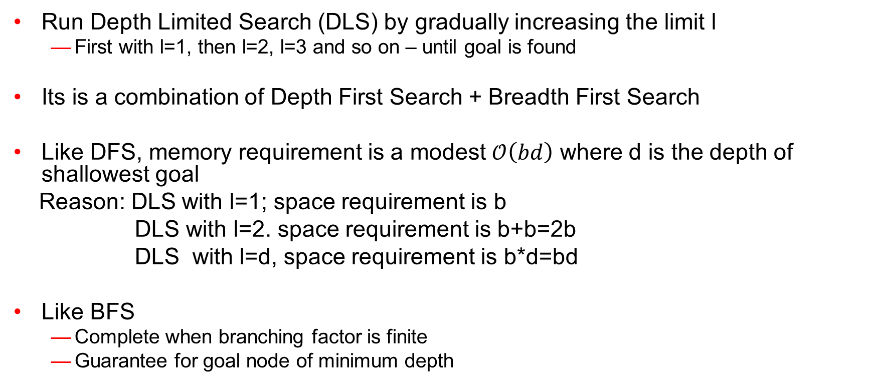
Iterative Deepening Depth First Search (IDS)
Run Depth Limited Search (DLS) by gradually increasing the limit l
First with l=1, then l=2, l=3 and so on – until goal is found
Its is a combination of Depth First Search + Breadth First Search
Like DFS, memory requirement is a modest $𝒪\left(bd\right)$ where d is the depth of shallowest goal
Reason: DLS with l=1; space requirement is b
DLS with l=2. space requirement is b+b=2b
DLS with l=d, space requirement is b*d=bd
Like BFS
Complete when branching factor is finite
Guarantee for goal node of minimum depth

Slide 52
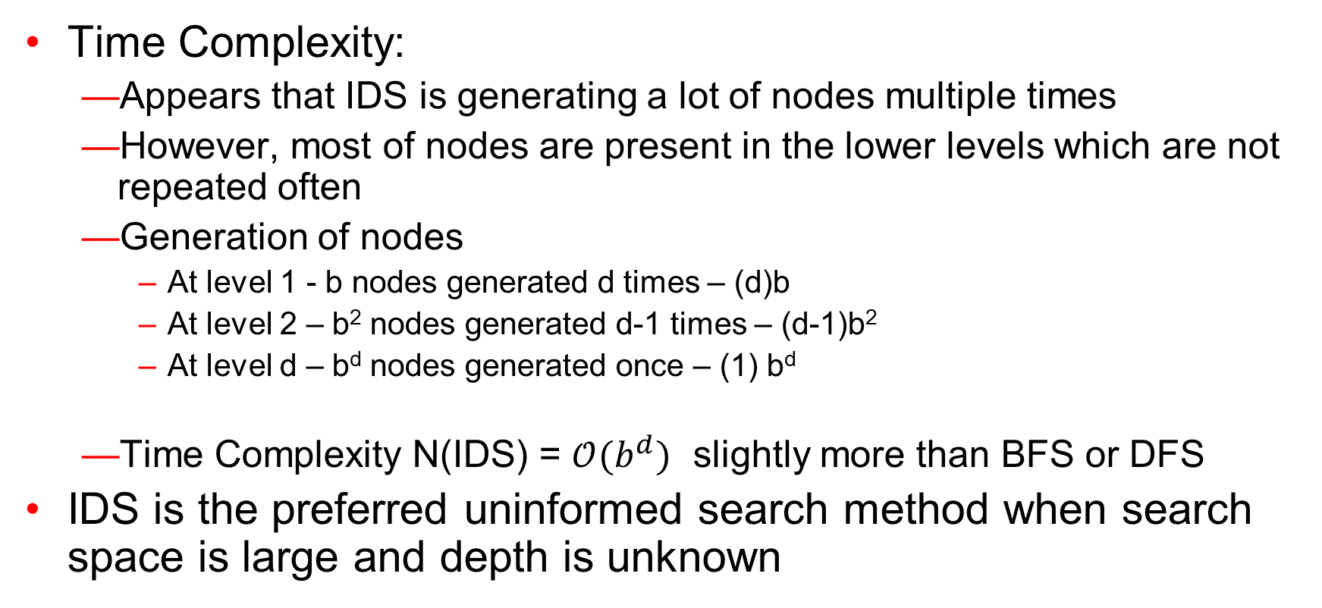
Iterative Deepening Depth First Search (IDS)
Time Complexity:
Appears that IDS is generating a lot of nodes multiple times
However, most of nodes are present in the lower levels which are not repeated often
Generation of nodes
At level 1 - b nodes generated d times – (d)b
At level 2 – b² nodes generated d-1 times – (d-1)b²
At level d – b^{d} nodes generated once – (1) b^{d}
Time Complexity N(IDS) = $𝒪(b^{d})$ slightly more than BFS or DFS
IDS is the preferred uninformed search method when search space is large and depth is unknown

Slide 53
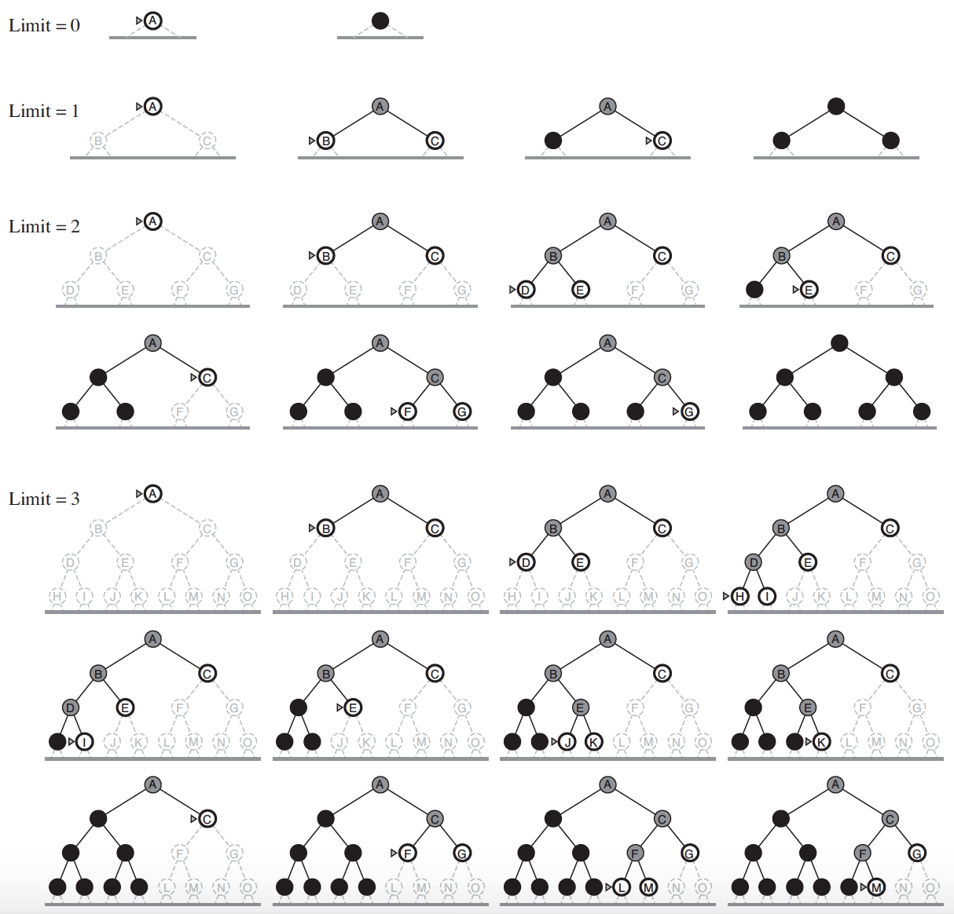
IDS

Slide 54
Uniform Cost Search
This algorithm is by Dijkstra [1959]. The algorithm expands nodes in the order of their cost from the source.
In uniform cost search the newly generated nodes are put in OPEN according to their path costs. This ensures that when a node is selected for expansion it is a node with the cheapest cost among the nodes in OPEN.
Let g(n) = cost of the path from the start node to the current node n. Sort nodes by increasing value of g.

Slide 55
Uniform Cost Search
Instead of expanding the shallowest node, Uniform-Cost search expands the node n with the lowest path cost g(n)
Sorting the Frontier as a priority queue ordered by g(n)
Goal test is applied during expansion
The goal node if generated may not be on the optimal path
Find a better path to a node on the Frontier

Slide 56
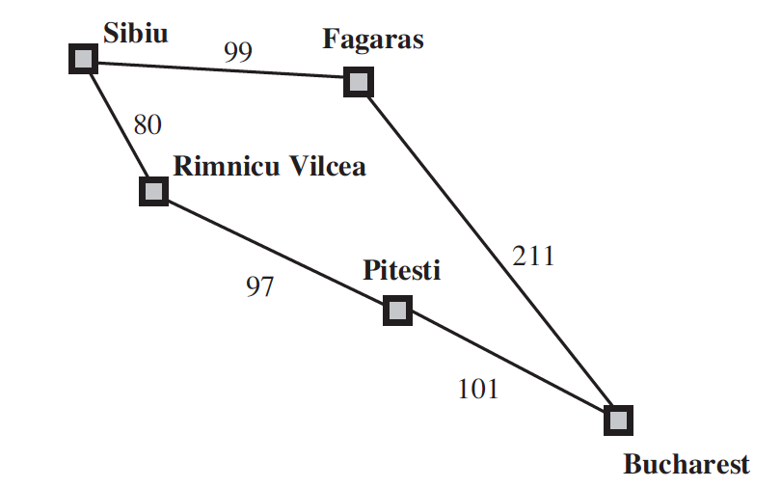
Uniform Cost Search
Current State: Sibiu
Frontier: []
Step: Expand Sibiu
Result: Generates (“Rimnicu Vilcea” 80)
(“Fagaras”, 99)
Add to Frontier
Initial State: Sibiu
Goal State: Bucharest

Slide 57
Uniform Cost Search
Current State: Sibiu
Frontier: [(“Rimnicu Vilcea” 80)
(“Fagaras”, 99)]
Step: Expand “Rimnicu Vilcea” (least cost)
Result: Generates (“Pitesti”, 177)
Add to Frontier
Initial State: Sibiu
Goal State: Bucharest

Slide 58
Uniform Cost Search
Current State: Rimnicu Vilcea (not a Goal state)
Frontier: [ (“Fagaras”, 99)
(“Pitesti”, 177)]
Step: Expand “Fagaras” (least cost)
Result: Generates (“Bucharest”, 310)
Add to Frontier
(It’s a Goal State but we won’t
test during generation)
Initial State: Sibiu
Goal State: Bucharest

Slide 59
Uniform Cost Search
Current State: Fagaras (not a goal state)
Frontier: [ (“Pitesti”, 177)
(“Bucharest”, 310)]
Step: Expand “Pitesti” (least cost)
Result: Generates (“Bucharest”, 278)
Replace in Frontier
(It’s a Goal State but we won’t
test during generation)
Initial State: Sibiu
Goal State: Bucharest

Slide 60
Uniform Cost Search
Current State: Pitesti (not a goal state)
Frontier: [ (“Bucharest”, 278)]
Step: Expand “Bucharest”
Result: No further generation
as Goal Test satisfied
Return Solution
Initial State: Sibiu
Goal State: Bucharest

Slide 61
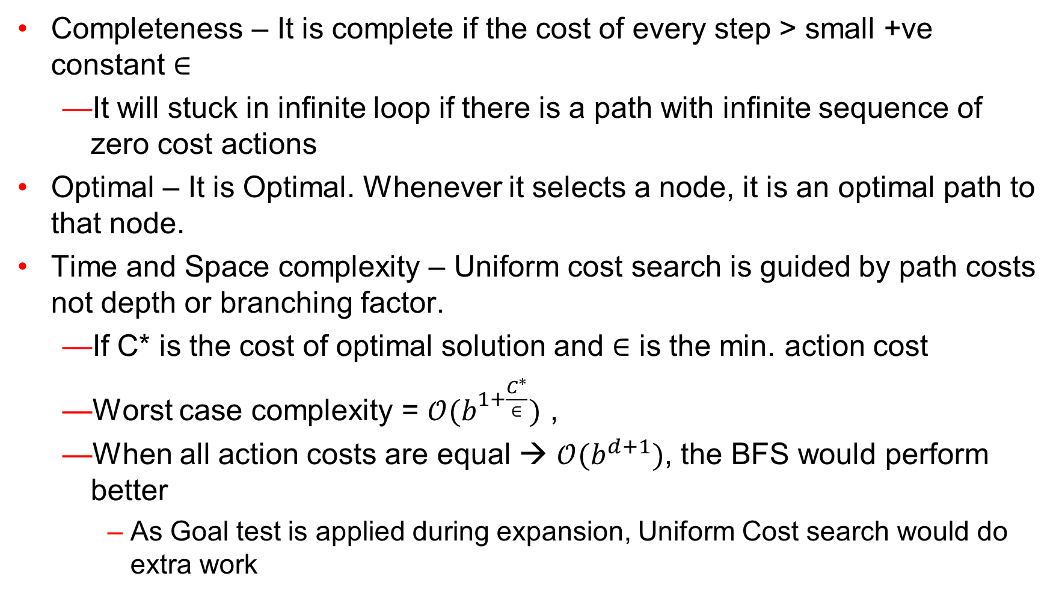
Uniform Cost Search – Evaluation
Completeness – It is complete if the cost of every step > small +ve constant $∈$
It will stuck in infinite loop if there is a path with infinite sequence of zero cost actions
Optimal – It is Optimal. Whenever it selects a node, it is an optimal path to that node.
Time and Space complexity – Uniform cost search is guided by path costs not depth or branching factor.
If C* is the cost of optimal solution and $∈$ is the min. action cost
Worst case complexity = $𝒪(b^{1+\frac{C^{∗}}{∈}})$ ,
When all action costs are equal → $𝒪(b^{d+1})$, the BFS would perform better
As Goal test is applied during expansion, Uniform Cost search would do extra work

